Slide 1
Knowledge Representation
Knowledge engineering: principles and pitfalls
Ontologies
Examples

Slide 2
Knowledge Engineer
Populates KB with facts and relations
Must study and understand domain to pick important objects and relationships
Main steps:
Decide what to talk about
Decide on vocabulary of predicates, functions & constants
Encode general knowledge about domain
Encode description of specific problem instance
Pose queries to inference procedure and get answers

Slide 3
Knowledge engineering vs. programming
Knowledge Engineering Programming
Choosing a logic Choosing programming language
Building knowledge base Writing program
Implementing proof theory Choosing/writing compiler
Inferring new facts Running program
Why knowledge engineering rather than programming?
Less work: just specify objects and relationships known to be true, but leave it to the inference engine to figure out how to solve a problem using the known facts.

Slide 4
Properties of good knowledge bases
Expressive
Concise
Unambiguous
Context-insensitive
Effective
Clear
Correct
…
Trade-offs: e.g., sacrifice some correctness if it enhances brevity.

Slide 5
Efficiency
Ideally: Not the knowledge engineer’s problem
The inference procedure should obtain same answers no matter how knowledge is implemented.
In practice:
- use automated optimization
- knowledge engineer should have some understanding of
how inference is done

Slide 6
Pitfall: design KB for human readers
KB should be designed primarily for inference procedure!
e.g.,VeryLongName predicates:
BearOfVerySmallBrain(Pooh) does not allow inference procedure to infer that Pooh is a bear, an animal, or that he has a very small brain, …
Rather, use:
Bear(Pooh)
b, Bear(b) ⇒ Animal(b)
a, Animal(a) ⇒PhysicalThing(a)
…
[See AIMA pp. 220-221 for full example]

Slide 7
Debugging
In principle, easier than debugging a program,
because we can look at each logic sentence in isolation and tell whether it is correct.
Example:
x, Animal(x) ⇒ ∃ b, BrainOf(x) = b
means
“there is some object that is the value of the BrainOf function applied to an animal”
and can be corrected to mean
“every animal has a brain”
without looking at other sentences.

Slide 8
Ontology
Collection of concepts and inter-relationships
Widely used in the database community to “translate” queries and concepts from one database to another, so that multiple databases can be used conjointly (database federation)

Slide 9
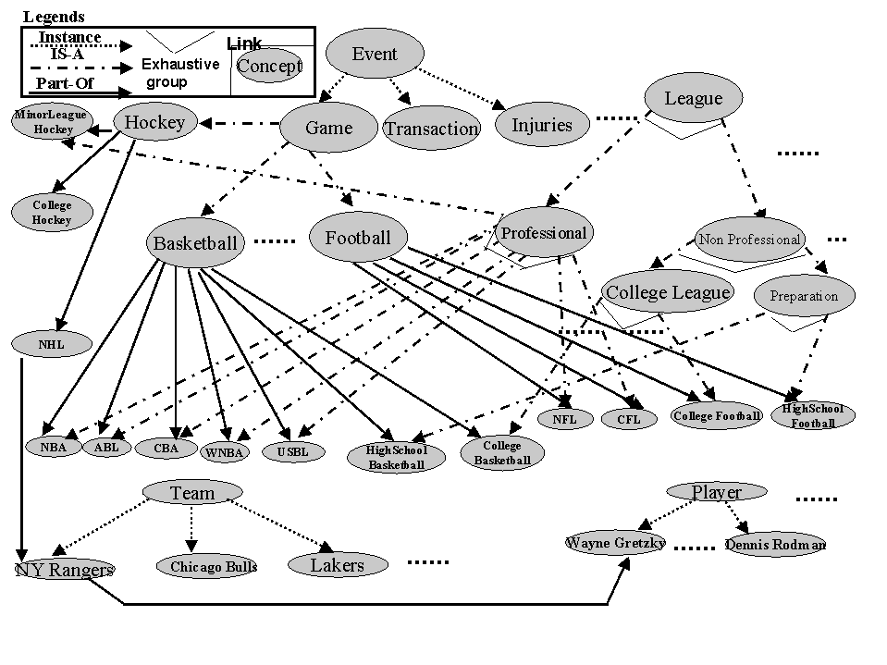
Ontology
Example
Khan & McLeod, 2000

Slide 10
Towards a general ontology
Develop good representations for:
categories
measures
composite objects
time, space and change
events and processes
physical objects
substances
mental objects and beliefs
…

Slide 11
Representing Categories
We interact with individual objects, but…
much of reasoning takes place at the level of categories.
Representing categories in FOL:
- use unary predicates
e.g., Tomato(x)
- reification: turn a predicate or function into an object
e.g., use constant symbol Tomatoes to refer to set of all tomatoes
“x is a tomato” expressed as “x∈Tomatoes”
Strong property of reification: can make assertions about reified category itself rather than its members
e.g., Population(Humans) = 5e9

Slide 12
Categories: inheritance
Allow to organize and simplify knowledge base
e.g., if all members of category Food are edible
and Fruits is a subclass of Food
and Apples is a subclass of Fruits
then we know (through inheritance) that apples are edible.
Taxonomy: hierarchy of subclasses
Because categories are sets, we handle them as such.
e.g., two categories are disjoint if they have no member in common
a disjoint exhaustive decomposition is called a partition
etc…

Slide 13
Example: Taxonomy of hand/arm movements
Hand/arm movement
Gestures Unintentional Movements
Manipulative Communicative
Acts Symbols
Mimetic Deictic Referential Modalizing
Quek,1994, 1995.

Slide 14
Measures
Can be represented using units functions
e.g., Length(L₁) = Inches(1.5) = Centimeters(3.81)
Measures can be used to describe objects
e.g., Mass(Tomato₁₂) = Kilograms(0.16)
Caution: be careful to distinguish between measures and objects
e.g., ∀b, b∈DollarBills ⇒ CashValue(b) = $(1.00)

Slide 15
Composite Objects
One object can be part of another.
PartOf relation is transitive and reflexive:
e.g., PartOf(Bucharest, Romania)
PartOf(Romania, EasternEurope)
PartOf(EasternEurope, Europe)
Then we can infer Part Of(Bucharest, Europe)
Composite object: any object that has parts

Slide 16
Composite Objects (cont.)
Categories of composite objects often characterized by their structure, i.e., what the parts are and how they relate.
e.g., ∀a Biped(a) ⇒
∃ ll, lr, b
Leg(ll) ∧ Leg(lr) ∧ Body(b) ∧
PartOf(ll, a) ∧ PartOf(lr, a) ∧ PartOf(b, a) ∧
Attached(ll, b) ∧ Attached(lr, b) ∧
ll ≠ lr ∧
∀x Leg(x) ∧ PartOf(x, a) ⇒ (x = ll ∨ x = lr)
Such description can be used to describe any objects, including events. We then talk about schemas and scripts.

Slide 17
Events
Chunks of spatio-temporal universe
e.g., consider the event WorldWarII
it has parts or sub-events: SubEvent(BattleOfBritain, WorldWarII)
it can be a sub-event: SubEvent(WorldWarII, TwentiethCentury)
Intervals: events that include as sub-events all events occurring in a given time period (thus they are temporal sections of the entire spatial universe).
Cf. situation calculus: fact true in particular situation
event calculus: event occurs during particular interval

Slide 18
Events (cont.)
Places: spatial sections of the spatio-temporal universe that extend through time
Use In(x) to denote subevent relation between places; e.g. In(NewYork, USA)
Location function: maps an object to the smallest place that contains it:
∀x,l Location(x) = l ⇔ At(x, l) ∧ ∀ll At(x, ll) ⇒ In(l, ll)

Slide 19
Times, Intervals and Actions
Time intervals can be partitioned between moments (=zero duration) and extended intervals:
Absolute times can then be derived from defining a time scale (e.g., seconds since midnight GMT on Jan 1, 1900) and associating points on that scale with events.
The functions Start and End then pick the earliest and latest moments in an interval. The function Duration gives the difference between end and start times.
∀i Interval(i) ⇒ Duration(i) = (Time(End(i) – Time(Start(i)))
Time(Start(AD1900)) = Seconds(0)
Time(Start(AD1991)) = Seconds(2871694800)
Time(End(AD1991)) = Seconds(2903230800)
Duration(AD1991) = Seconds(31536000)

Slide 20
Times, Intervals and Actions (cont.)
Then we can define predicates on intervals such as:
∀i, j Meet(i, j) ⇔ Time(End(i)) = Time(Start(j))
∀i, j Before(i, j) ⇔ Time(End(i)) < Time(Start(j))
∀i, j After(j, i) ⇔ Before(i ,j)
∀i, j During(i, j) ⇔ Time(Start(j)) ≤ Time(Start(i)) ∧
Time(End(j)) ≥ Time(End(i))
∀i, j Overlap(i, j) ⇔ ∃k During(k, i) ∧ During(k, j)

Slide 21
Objects Revisited
It is legitimate to describe many objects as events
We can then use temporal and spatial sub-events to capture changing properties of the objects
e.g.,
Poland event
19thCenturyPoland temporal sub-event
CentralPoland spatial sub-event
We call fluents objects that can change across situations.

Slide 22
Substances and Objects
Some objects cannot be divided into distinct parts –
e.g., butter: one butter? no, some butter!
butter substance (and similarly for temporal substances)
(simple rule for deciding what is a substance: if you cut it in half, you should get the same).
How can we represent substances?
- Start with a category
e.g., ∀x,y x ∈ Butter ∧ PartOf(y, x) ⇒ y ∈ Butter
- Then we can state properties
e.g., ∀x Butter(x) ⇒ MeltingPoint(x, Centigrade(30))

Slide 23
Example: Activity Recognition
Goal: use network of video cameras to monitor human activity
Applications: surveillance, security, reactive environments
Research: IRIS at USC

Slide 24
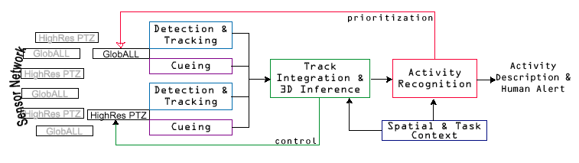
Human activity detection
Nevatia/Medioni/Cohen

Slide 25
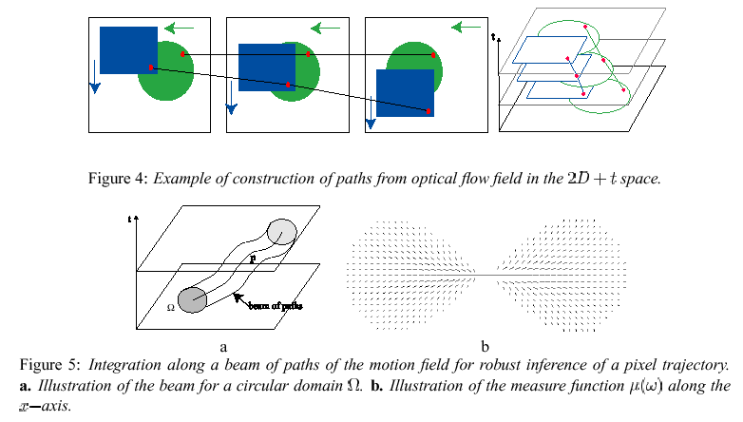
Low-level processing

Slide 26
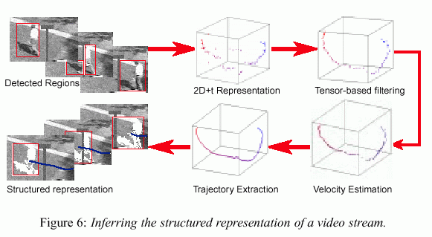
Spatio-temporal representation

Slide 27
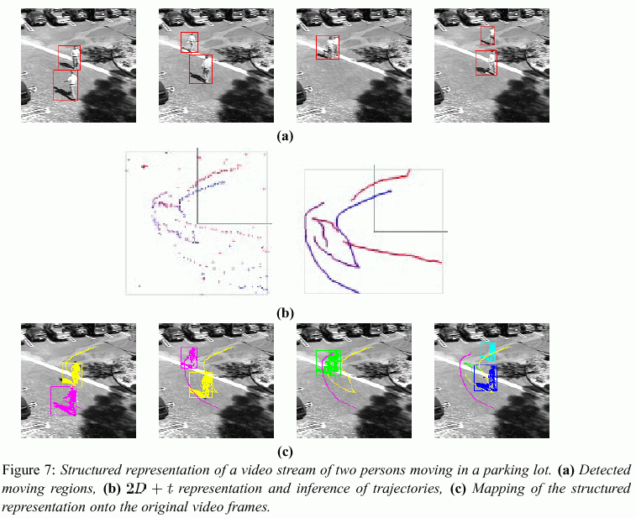

Slide 28
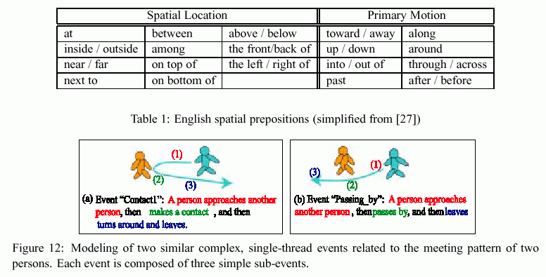
Modeling Events

Slide 29
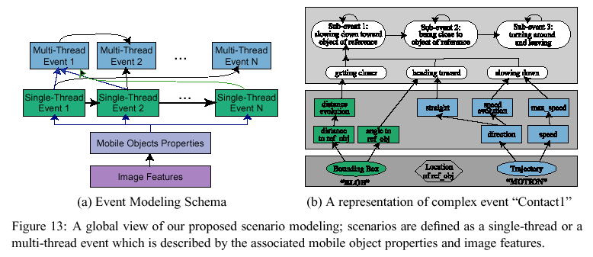
Modeling Events

Slide 30
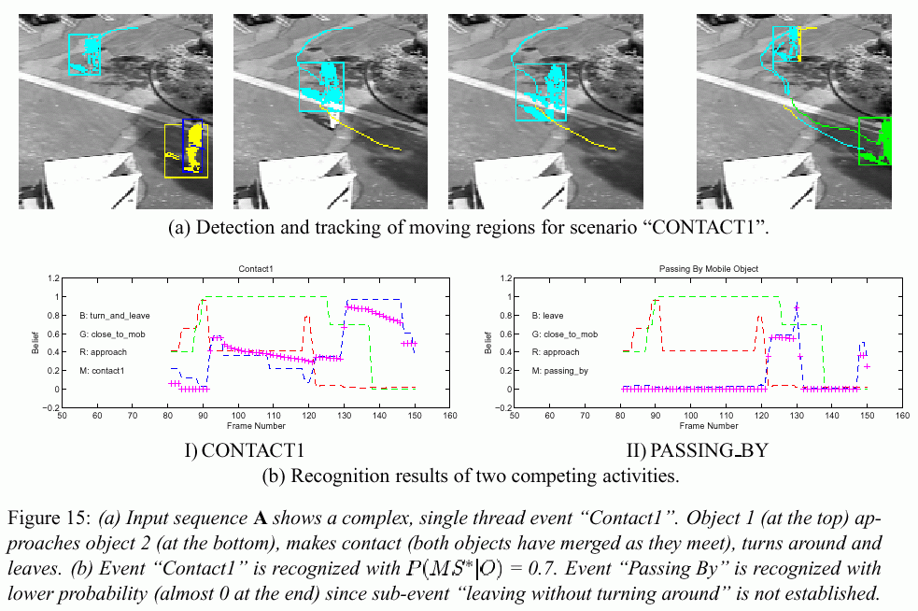

Slide 31
Example 2: towards autonomous vision-based robots
Goal: develop intelligent robots for operation in unconstrained environments
Subgoal: want the system to be able to answer a question based on its visual perception
e.g., “Who is doing what to whom?”
While the robot is observing its environment.

Slide 32
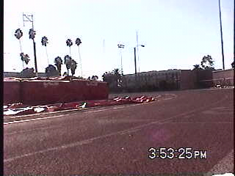
Example
Question: “who is doing what to whom?”
Answer: “Eric passes, turns around and passes again”

Slide 33
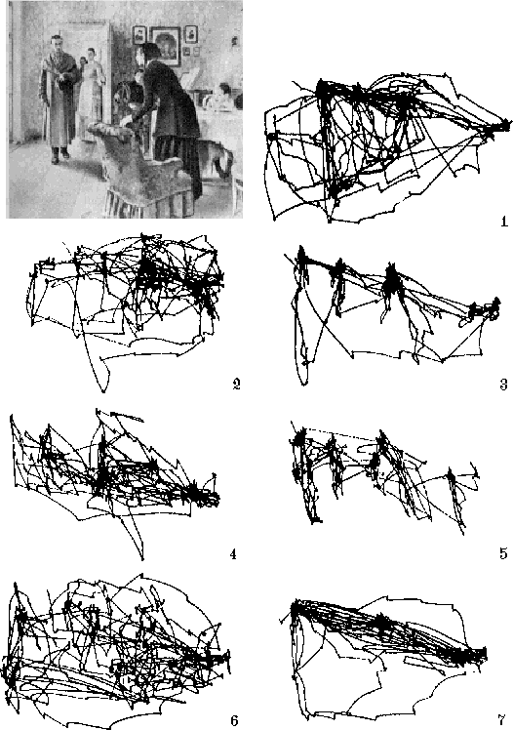
Motivation:
Humans
1) Free examination
2) estimate material
circumstances of family
3) give ages of the people
4) surmise what family has
been doing before arrival
of “unexpected visitor”
5) remember clothes worn by
the people
6) remember position of people
and objects
7) estimate how long the “unexpected
visitor” has been away from family
Yarbus, 1967

Slide 34
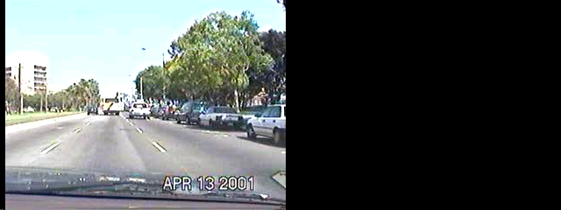
Minimal subscene
Extract “minimal subscene” (i.e., small number of objects and
actions) that is relevant to present behavior.
Achieve representation for it that is robust and stable against
noise, world motion, and egomotion.

Slide 35
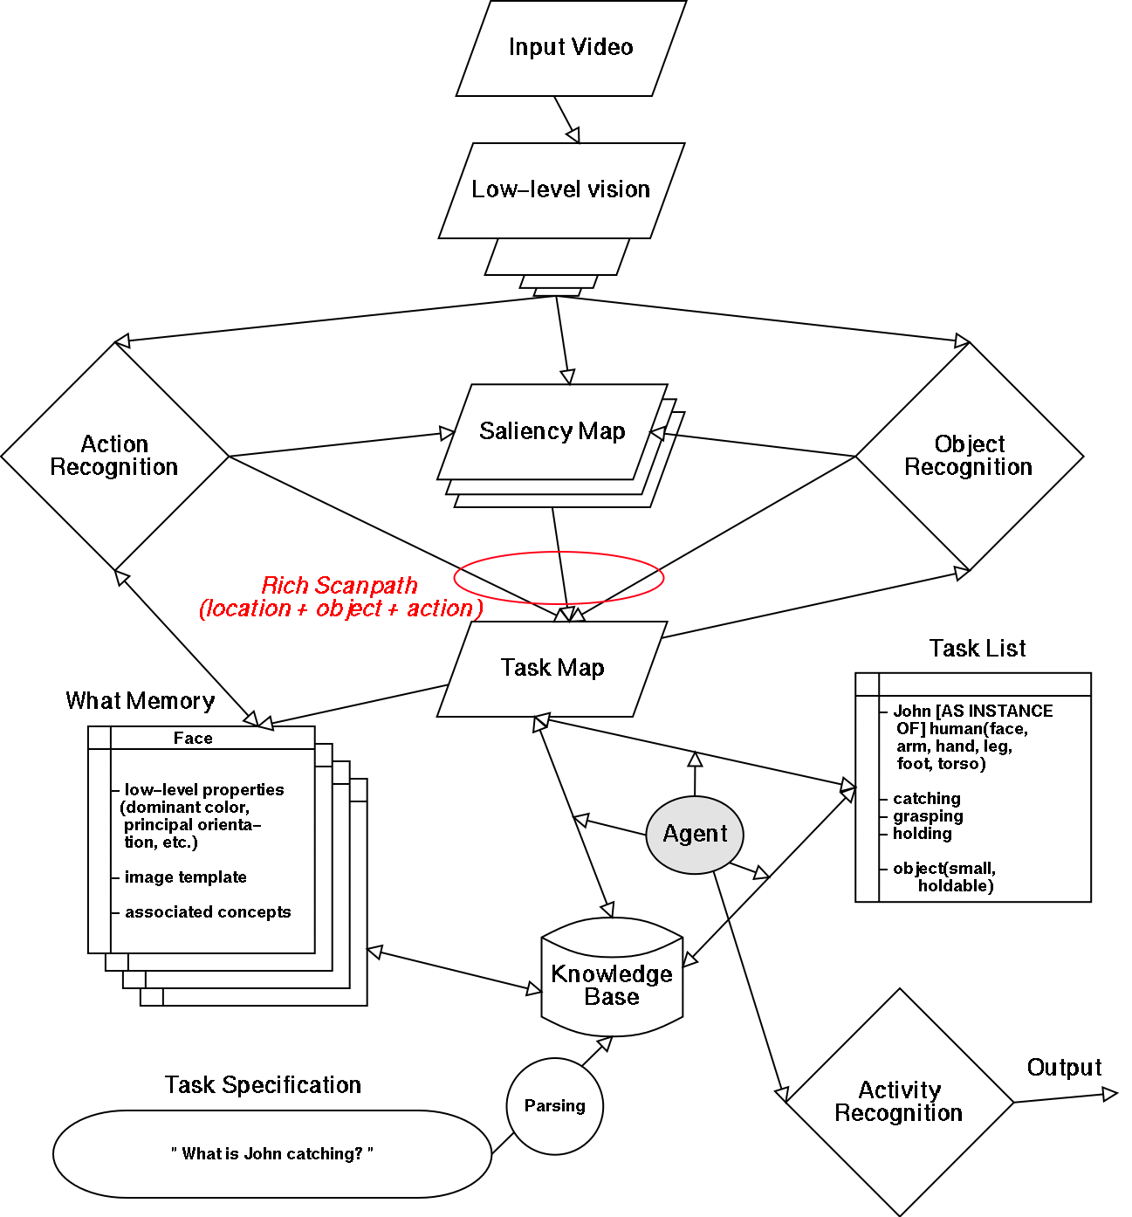
General architecture

Slide 36
Example of operation
Question: “What is John catching?”
Video clip: John catching a ball
Initially: empty task map and task list
2) Question mapped onto a sentence frame
allows agent to fill some entries in the task list:
- concepts specifically mentioned in the question
- related concepts inferred from KB (ontology)
e.g., task list contains:
“John [AS INSTANCE OF] human(face, arm, hand,
leg, foot, torso)” (all derived from “John”)
“catching, grasping, holding” (derived from “catching”)
“object(small, holdable)” (derived from “what”).

Slide 37
More formally: how do we do it?
Use ontology to describe categories, objects and relationships:
Either with unary predicates, e.g., Human(John),
Or with reified categories, e.g., John ∈ Humans,
And with rules that express relationships or properties,
e.g., ∀x Human(x) ⇒ SinglePiece(x) ∧ Mobile(x) ∧ Deformable(x)
Use ontology to expand concepts to related concepts:
E.g., parsing question yields “LookFor(catching)”
Assume a category HandActions and a taxonomy defined by
catching ∈ HandActions, grasping ∈ HandActions, etc.
We can expand “LookFor(catching)” to looking for other actions in the category where catching belongs through a simple expansion rule:
∀a,b,c a ∈ c ∧ b ∈ c ∧ LookFor(a) ⇒ LookFor(b)

Slide 38
More formally: how do we do it?
Use composite objects to describe structure and parts:
∀h Human(h) ⇒ ∃ f, la, ra, lh, rh, ll, rl, lf, rf, t
Face(f) ∧ Arm(la) ∧ Arm(ra) ∧ Hand(lh) ∧ Hand(rh) ∧
Leg(ll) ∧ Leg(rl) ∧ Foot(lf) ∧ Foot(rf) ∧ Torso(t) ∧
PartOf(f, h) ∧ PartOf(la, h) ∧ PartOf(ra, h) ∧ PartOf(lh, h) ∧
PartOf(rh, h) ∧ PartOf(ll, h) ∧ PartOf(rl, h) ∧ PartOf(lf, h) ∧
PartOf(rf, h) ∧ PartOf(t, h) ∧
Attached(f, t) ∧ Attached(la, b) ∧ Attached(ra, b) ∧ Attached(ll, b) ∧
Attached(rl, t) ∧ Attached(lh, la) ∧ Attached(rh, ra) ∧
Attached(lf, ll) ∧ Attached(rf, rl) ∧ Attached(rh, ra) ∧
la ≠ ra ∧ lh ≠ rh ∧ ll ≠ rl ∧ lf ≠ rf ∧
∀x Leg(x) ∧ PartOf(x, a) ⇒ (x = ll ∨ x = rl) ∧ [etc…]

Slide 39
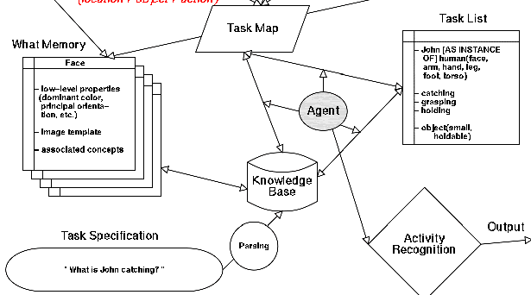

Slide 40
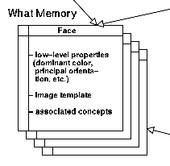
Example of operation
3) Task list creates top-down biasing signals onto vision, by associating concepts in task list to low-level image features in “what memory”
e.g., “human” => look for strong vertically-oriented features
“catching” => look for some type of motion
In more complex scenarios, not only low-level visual features, but also feature interactions, spatial location, and spatial scale and resolution may thus be biased top-down.

Slide 41
More formally: how do we do it?
Use measures to quantify low-level visual features and weights:
e.g., describing the color of a face:
∀f Face(f) ⇒
Red(f) = Fweight(0.8) ∧ Green(f) = Fweight(0.5) ∧ Blue(f) = Fweight(0.5)
[or use predicates similar to those seen for intervals to express ranges of feature weights]
e.g., recognizing face by measuring how well it matches a template:
∀f RMSdistance(f, FaceTemplate) < Score(0.1) ⇒ Face(f)
e.g., biasing the visual system to look for face color:
∀f Face(f) ∧ LookFor(f) ⇒ RedWeight = Red(f) ∧ GreenWeight = Green(f) ∧
BlueWeight = Blue(f)
[may eliminate Face(f) if Red(), Green() and Blue() defined for all objects we might look for]

Slide 42
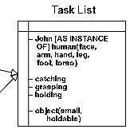
Example of operation
4) Suppose that the visual system first attends to a bright-red chair in the scene.
Going through current task list, agent determines that this object is most probably irrelevant (not really “holdable”)
Discard it from further consideration as a
component of the minimal subscene.
Task map and task list remain unaltered.

Slide 43
More formally: how do we do it?
What is the task list, given our formalism?
it’s a question to the KB: ASK(KB, ∃x LookFor(x))
Is the currently attended and recognized object, o, of interest?
ASK(KB, LookFor(o))
How could we express that if the currently attended & recognized object is being looked for, we should add it to the minimal subscene?
∀x Attended(x) ∧ Recognized(x) ∧ LookFor(x) ∧
x ∉ MinimalSubscene ⇒ x ∈ MinimalSubscene
with:
∀x ∃t RMSdistance(x, t) < Score(0.1) ⇒ Recognized(x)
and similar for Attended() [Note: should be temporally tagged; see next]

Slide 44
Example of operation
5) Suppose next attended and identified object is John’s rapidly tapping foot.
This would match the “foot” concept in the task list.
Because of relationship between foot and human (in KB), agent can now prime visual system to look for a human that overlap with foot found:
- feature bias derived from what memory for human
- spatial bias for location and scale
Task map marks this spatial region as part of the current minimal subscene.

Slide 45
Example of operation
6) Assume human is next detected and recognized
System should then look for its face
how? from KB we should be able to infer that resolving
“? [AS INSTANCE OF] human”
can be done by looking at the face of the human.
Once John has been localized and identified, entry
“John [AS INSTANCE OF] human(face, arm, hand, leg, foot, torso)”
simplifies into simpler entry
“John [AT] (x, y, scale)”
Thus, further visual biasing will not attempt to further localize John.

Slide 46
More formally: how do we do it?
How do we introduce the idea of successive attentional shifts and progressive scene understanding to our formalism?
Using situation calculus!
Effect axioms (describing change):
∀x,s Attended(x, s) ∧ Recognized(x, s) ∧ LookFor(x, s) ⇒
¬LookFor(x, Result(AddToMinimalSubscene, s))
with AddToMiminalSubscene a shorthand for a complex sequence of actions to be taken (remember how very long predicates should be avoided!)
Successor-state axioms (better than the frame axioms for non-change):
∀x,a,s x ∈ MinimalSubscene(Result(a, s)) ⇔
(a = AddToMinimalSubscene) ∨
(x ∈ MinimalSubscene(s) ∧ a ≠ DeleteFromminimalSubscene)

Slide 47
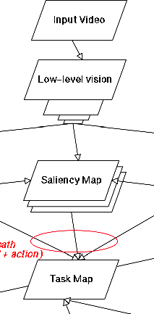
Example of operation
7) Suppose system then attends to the bright green emergency exit sign in the room
This object would be immediately discarded because it is too far from the currently activated regions in the task map.
Thus, once non-empty, the task map acts as a filter that makes it more difficult (but not impossible) for new information to reach higher levels of processing, that is, in our model, matching what has been identified to entries in the task list and deciding what to do next.

Slide 48
Example of operation
8) Assume that now the system attends to John’s arm motion
This action will pass through the task map (that contains John)
It will be related to the identified John (as the task map will not only specify spatial weighting but also local identity)
Using the knowledge base, what memory, and current task list the system would prime the expected location of John’s hand as well as some generic object features.

Slide 49
Example of operation
9) If the system attends to the flying ball, it would be incorporated into the minimal subscene in a manner similar to that by which John was (i.e., update task list and task map).
10) Finally: activity recognition.
The various trajectories of the various objects that have been recognized as being relevant, as well as the elementary actions and motions of those objects, will feed into the activity recognition sub-system
=> will progressively build the higher-level, symbolic understanding of the minimal subscene.
e.g., will put together the trajectories of John’s body, hand, and of the ball into recognizing the complex multi-threaded event “human catching flying object.”

Slide 50
Example of operation
11) Once this level of understanding is reached, the data needed for the system’s answer will be in the form of the task map, task list, and these recognized complex events, and these data will be used to fill in an appropriate sentence frame and apply the answer.

Slide 51
Reality or fiction?
Ask your colleague, Vidhya Navalpakkam!

Slide 52
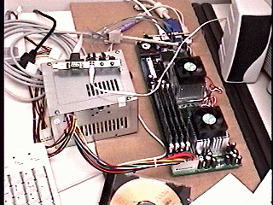
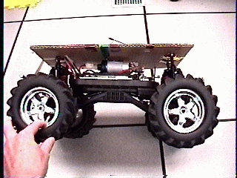
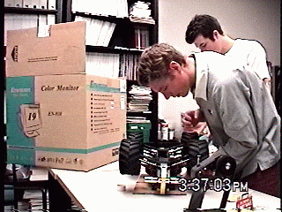
Meanwhile…
Beobots are coming to life!

Slide 53
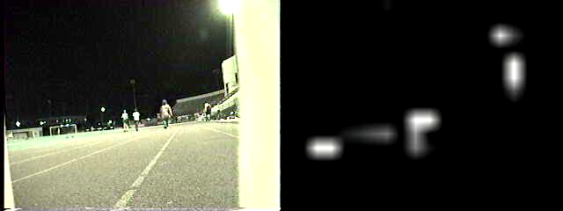
Meanwhile…
And they can see!

Slide 54
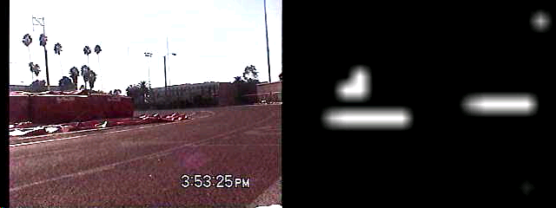
Example
Question: “who is doing what to whom?”
Answer: “Eric passes, turns around and passes again”

